Slide 1
Automatic Night Light using Logic gate
Digital Logic Design Lab
Project Presentation

Slide 2
About the project
Name : Jihad
ID: 202002082
Name: Shah Jalal
ID:202002071
Section: DC
Course Teacher :
Name: Mr.Mozdaher Abdul Quader
Green University of Bangladesh

Slide 3
Table of contents
About the project
Objectives
Advantage & disadvantage
Components
Circuit diagram
Working Process
Application

Slide 4
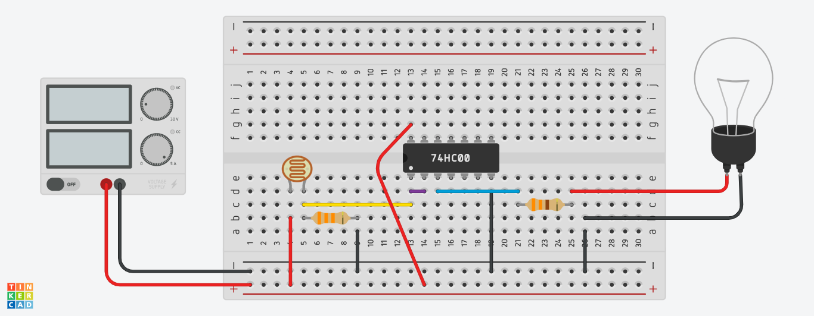
ABOUT THE PROJECT
In this project, we will build a night light circuit using a NAND gate chip. A night light circuit is a circuit in which a light will turn on when the environment becomes dark. It is a popular commercial product that is used in many places such as for backyard lights for when it gets dark for automatic illumination.

Slide 5
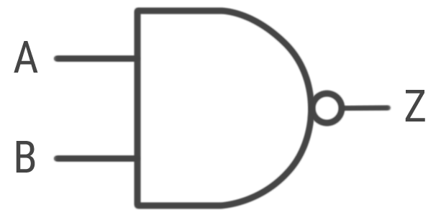
Objectives
In this project, we will build a night light circuit using a NAND gate chip.

Slide 6
ADVANTAGE & DISADVANTAGE
ADVANTAGE
This circuit save time.
It save power.
Help to smart life.
Automatic control.
DISADVANTAGE
Sometime it problem in could weather.

Slide 7
Components
BREADBOARD
74hc00n IC
9V Battery
GL5537 Photoresistor
LED
330 Ohm Resistors
33k Ohm Resistors
Wires

Slide 8
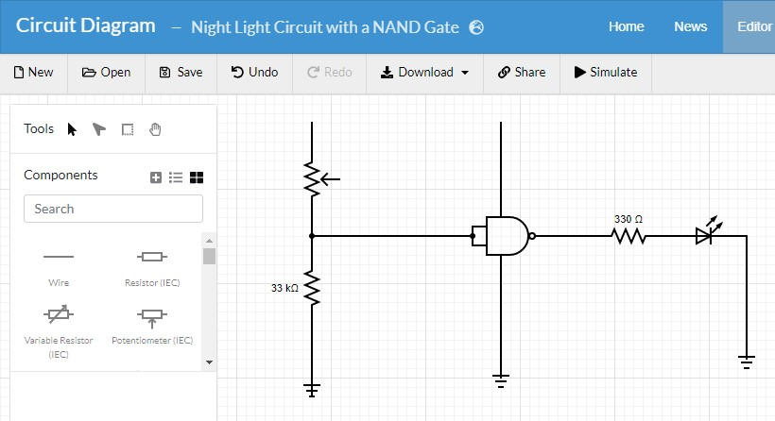
Circuit Diagram
The schematic diagram of the night light circuit using a 74hc00 NAND gate chip is shown below.
+5V
+5V
photoresistor
Pin 1
LED
Pin 3
Pin 2
Pin 7

Slide 9
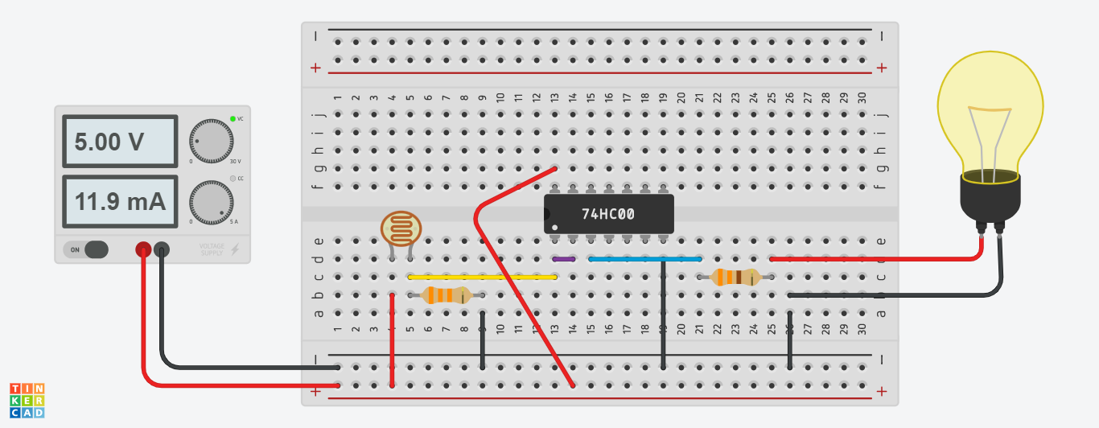
Working Process

Slide 10
Application
Road light Control
Lamp post
Home Security Light
Signal Light
CC Camera ( Night Mode)

Slide 11
Thanks

